Slide 1

























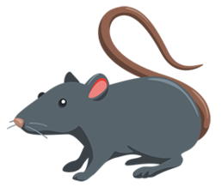


Emoji Film Quiz
World Emoji Day = 17 July)
1
7
2
8
3
9
4
10
5
11
6
12

Slide 2
Emoji Film Quiz
World Emoji Day = 17 July)
1
Jungle Book
Monsters Inc.
The Greatest Showman
Inside Out
Star Wars
Titanic
7
Moana
Jurassic Park
Finding Nemo
Dumbo
Ghostbusters
Ratatouille
2
8
3
9
4
10
5
11
6
12

